Slide 1


Post replication events
Lecture 8
Dr. Rawa Abdul Redha Aziz
Ph.D Antibiotics/ Molecular biology

Slide 2
Introduction
The post-replication modifications are conferred on newly synthesized DNA while being packaged into chromatin. They include the methylation of cytosine residues on hemi-methylated DNA and also de novo methylation.
The marking of histone tails with post-translational modifications like acetylation, methylation, phosphorylation, and ubiqutination.

Slide 3
DNA methylation
It is a biochemical process involving the addition of a methyl group (CH3) to the cytosine or adenine DNA nucleotides. The main function of DNA methylation in bacteria is to provide a mechanism, which protects the cell from the effect of foreign DNA introduction. Restriction endonucleases discriminate between endogenous and foreign DNA by its methylation pattern. The extensive research on methylation was conducted on bacteria. Both adenine and cytosine can be methylated, and this modification is involved in DNA replication and arrangement. These specific nucleases, however, would not cleave at these specific Palindromic sequences if the DNA was methylated

Slide 4
Function of DNA methylation in prokaryotes
The main function of DNA methylation in bacteria is to provide a mechanism, which protects the cell from the effect of foreign DNA introduction
Another function of DNA methylation in prokaryotes is the involvement in the control of replication fidelit
The restriction/modification system in bacteria is a small-scale immune system for protection from infection by foreign DNA.
The newly synthesized complementary strand must be methylated as the parent strand.

Slide 5
The methylation occurs at specific site at specific DNA sequences (5 c position in cytosine and N6 nitrogen position in adenine). The responsible enzyme is Methytransferase

Slide 6
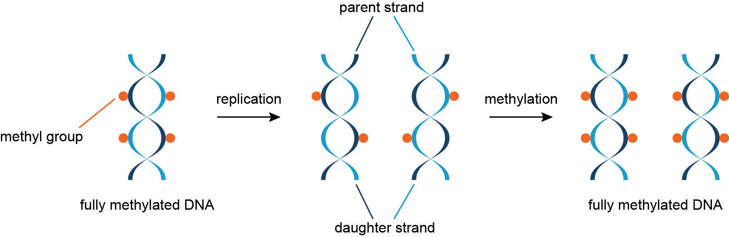

Slide 7
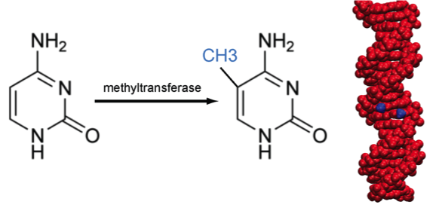
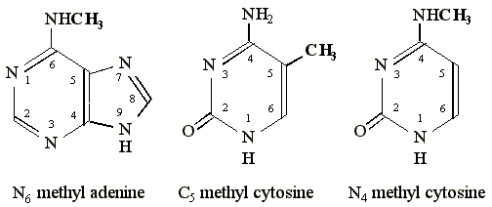

Slide 8
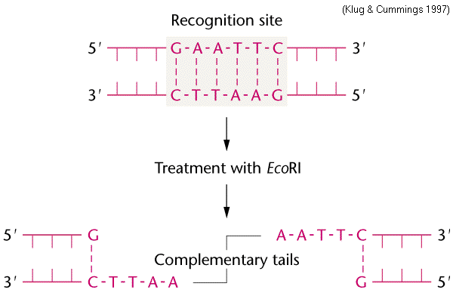

Slide 9
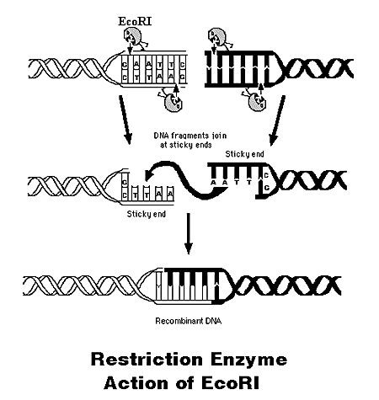

Slide 10
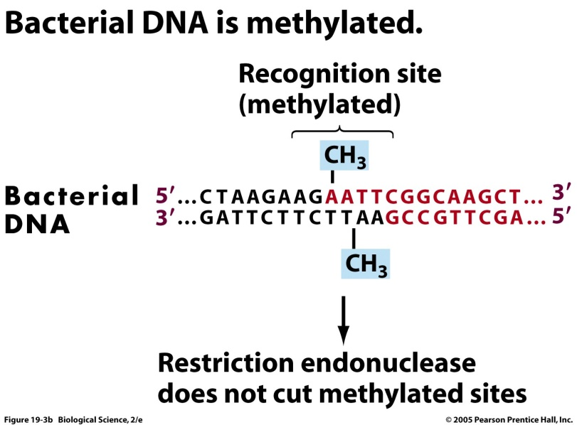

Slide 11
E. coli DNA adenine methyltransferase (Dam)
It is an enzyme of ~32 kDa (not belong to restriction\ modification system). The target recognition sequence for E. coli Dam is GATC (not GAATTC) as the methylation occurs at the N6 position of the adenine in this sequence (G meATC). The three base pairs flanking each side also influence with DNA–Dam binding. Dam plays several key roles in bacterial processes, including mismatch repair, the timing of DNA replication, and gene expression

Slide 12
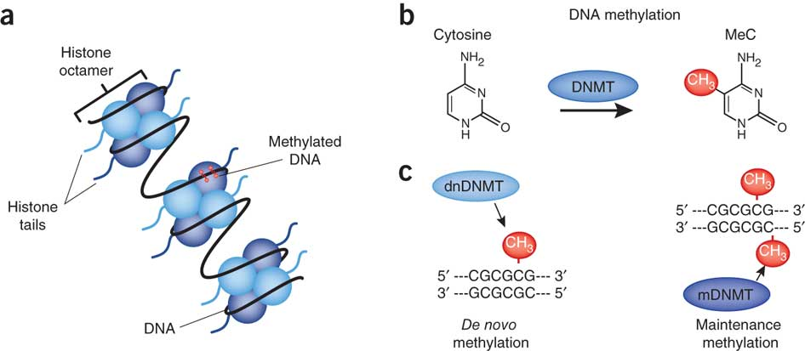
Eukaryotic DNA methylation

Slide 13
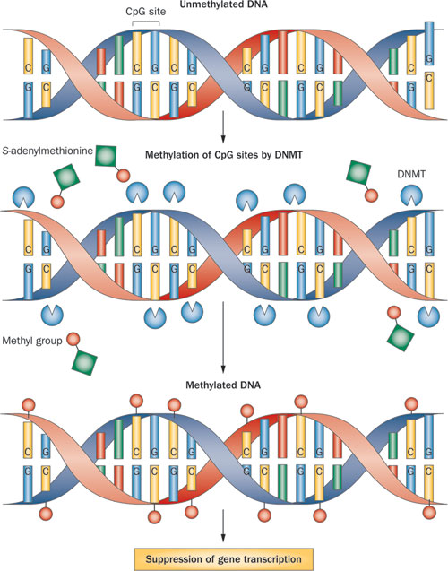

Slide 14
DNA repair and proofreading activity
The Base Excision Repair Pathway (BER)
Nucleotide excision repair
Mismatch Repair System

Slide 15
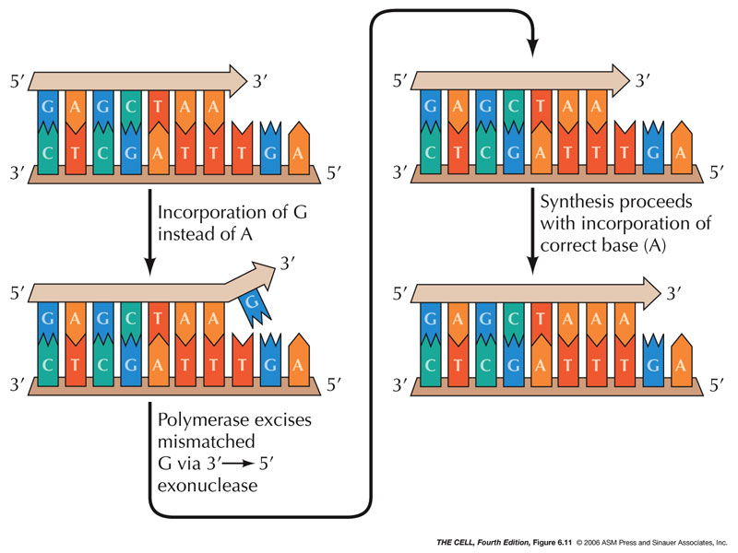

Slide 16
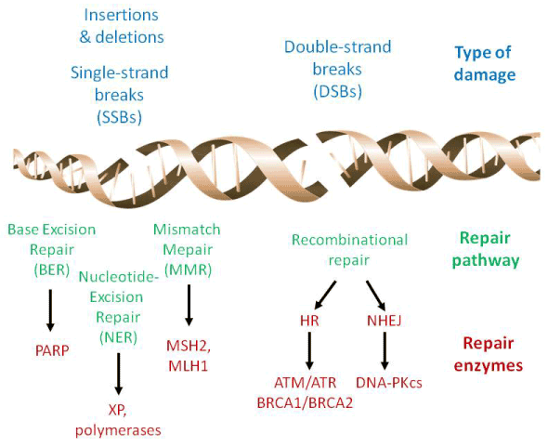

Slide 17


